Slide 1

MAJOR PROJECT
The Department of Computer Science & Engineering
MASTER’S OF COMPUTER APPLICATION
2023-2025
Sarala Birla University, Ranchi
MAY - 2025
by
Praneet Kumar Pathak [ SBU233465 ]
Manish Kumar Sharma [ SBU233225 ]
Under the Guidance of
Dr. Avinash Kumar
Associate Professor, SBU
Dept. of CSE

Slide 2
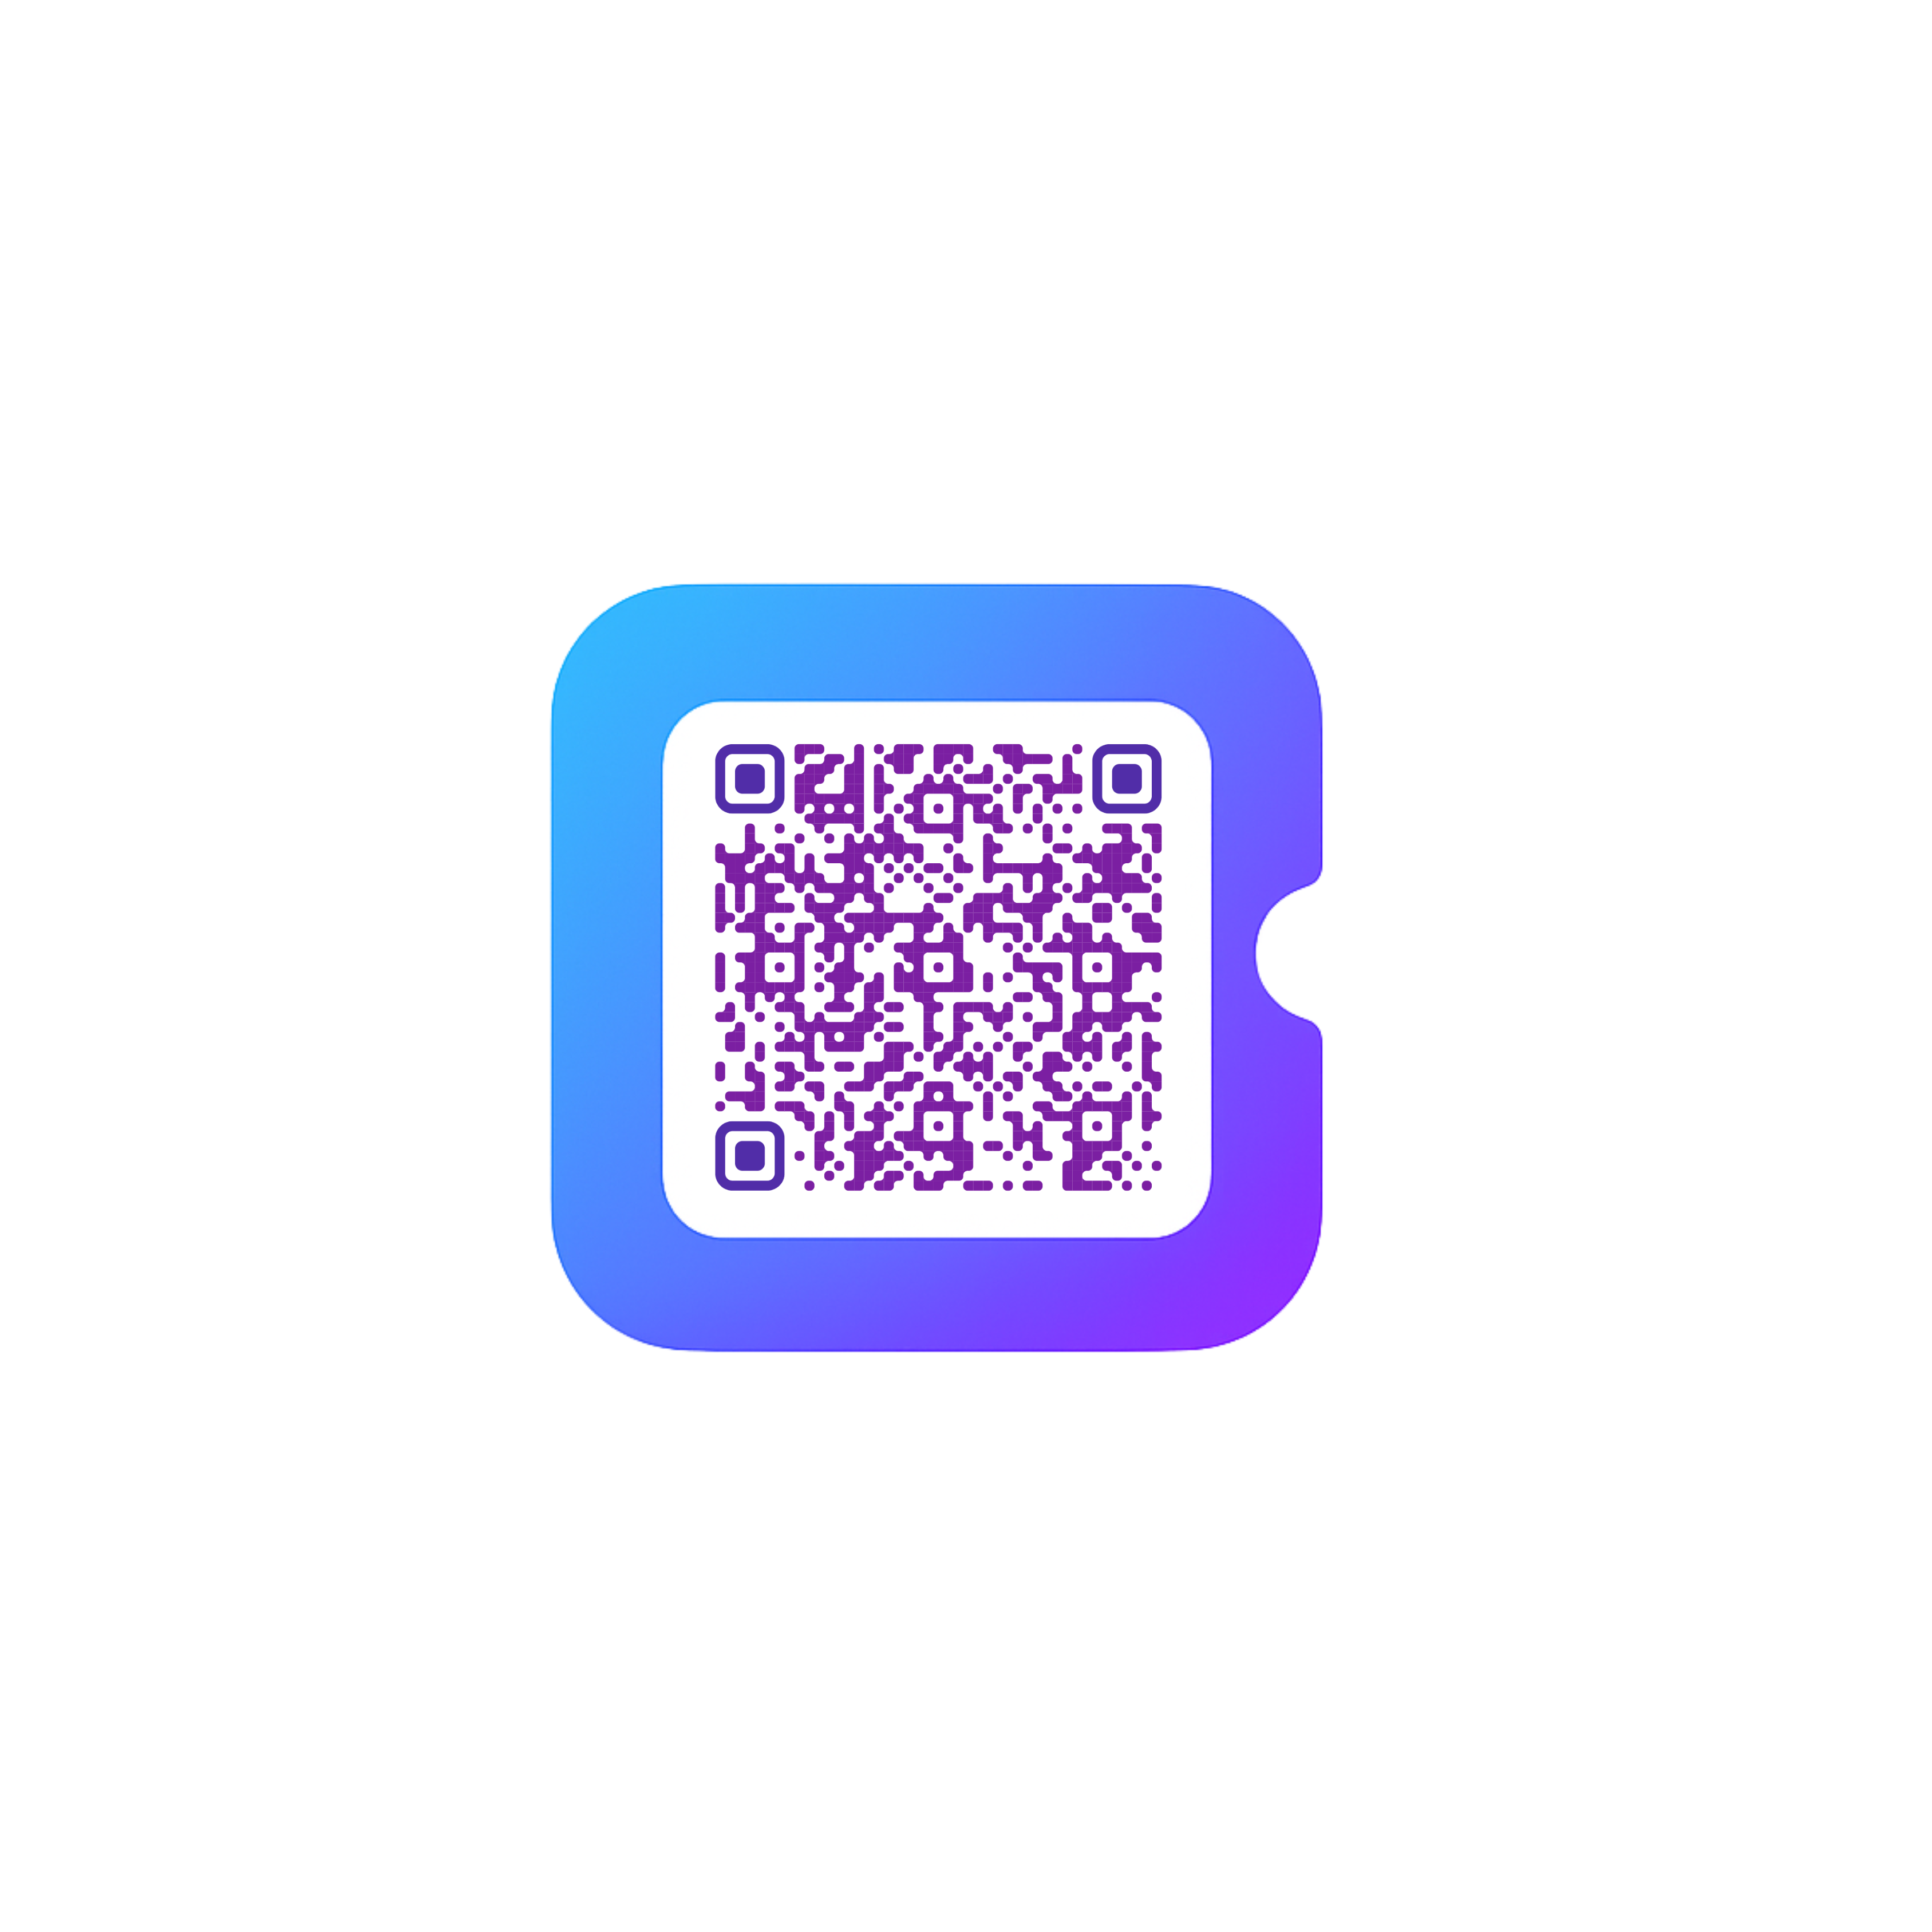
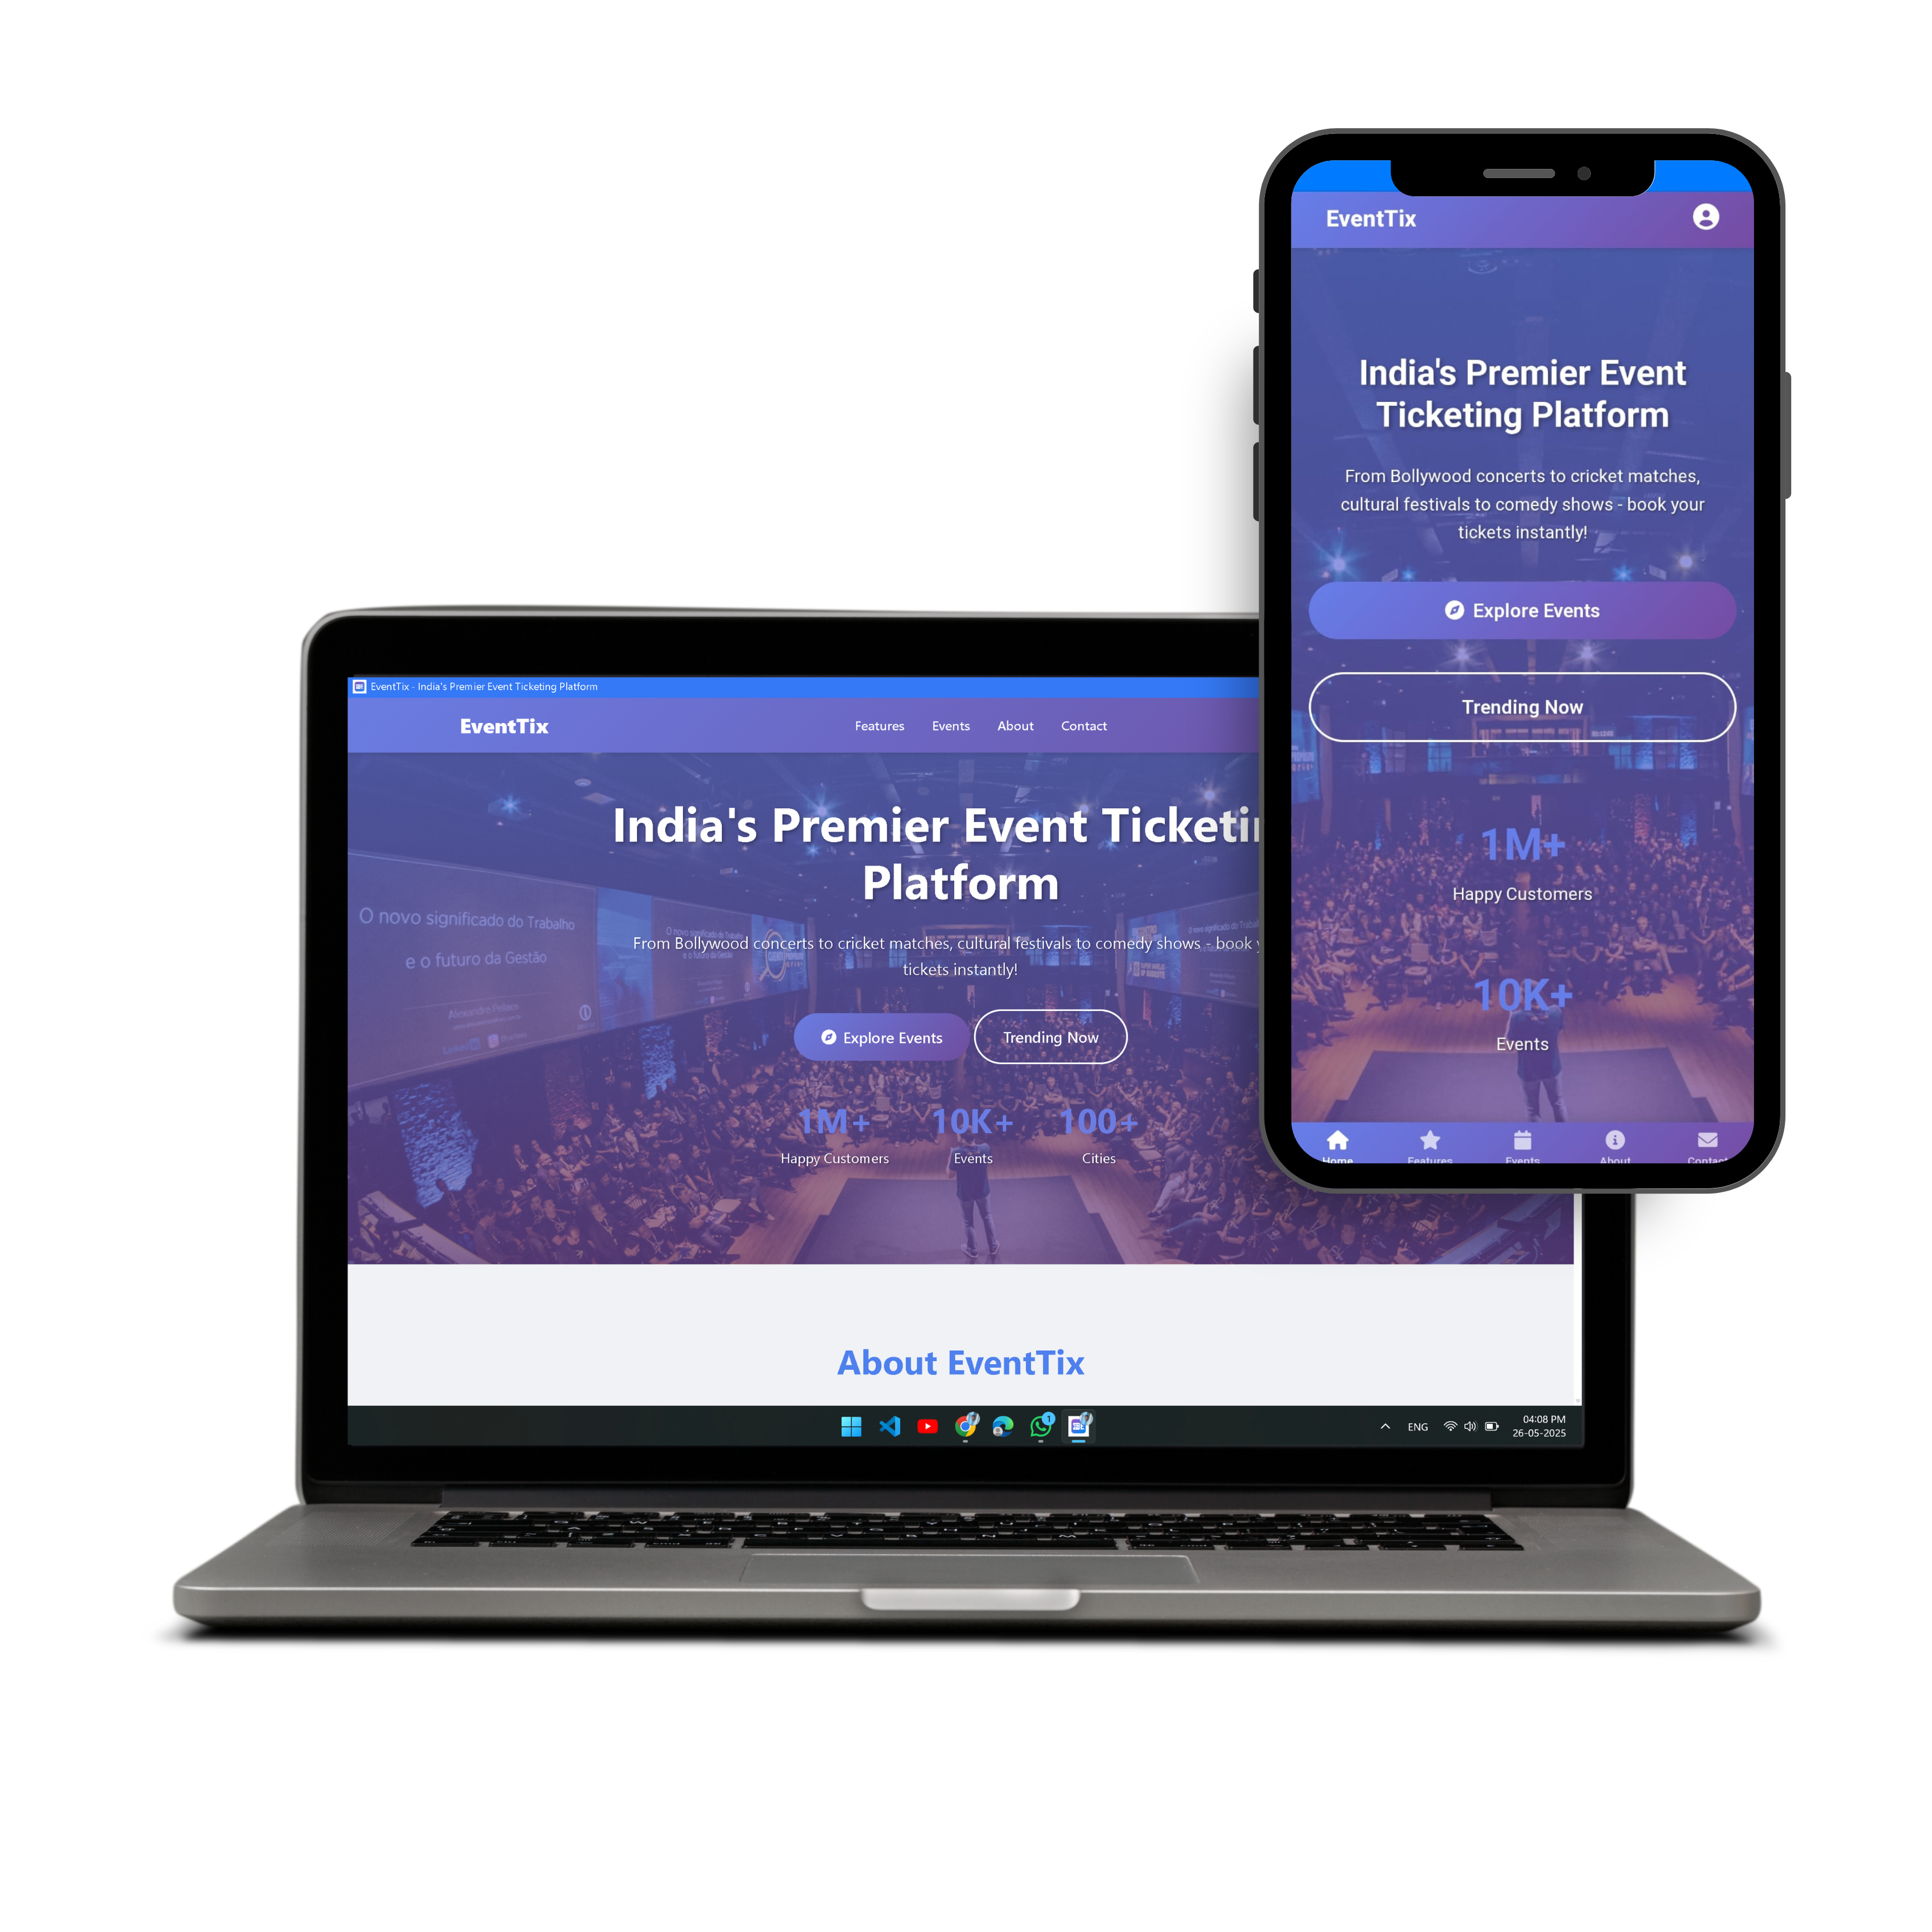
EventTix – Event Ticket Management System
EventTix is a web-based event ticket management platform designed to simplify and automate the process of ticket booking, distribution, and verification for various types of events. Whether it’s a conference, concert, seminar, workshop, or hybrid gathering, EventTix provides a seamless experience for both event organizers and attendees.
The platform is built using HTML, CSS, JavaScript, and is powered by Firebase for backend functionalities such as database and authentication. It also integrates EmailJS for automated ticket delivery via email and uses a QR Code API to generate scannable digital tickets for entry validation.

Slide 3

About EventTix
What is EventTix?
Why Choose EventTix?
A web platform for secure event creation and ticket booking.
Efficient, simple, and custom for hybrid events.
Technology Stack
Frontend: HTML, CSS, JavaScript
Backend & DB: Firebase Firestore & Auth
Email: EmailJS
QR Code API

Slide 4

Problem Statement
Challenges
Hybrid Event Needs
Manual ticketing causes fraud, delays, and poor tracking.
Lack of platforms supporting both online and offline events.
Objective
Develop a real-time digital ticketing and validation solution.

Slide 5
Project Objectives
User-Focused
Admin-Focused
Browse and Book Events
Users can explore upcoming online, offline, or hybrid events and easily book tickets via a user-friendly interface.
Secure Admin Login & Event Management
Admins log in via Firebase Auth to add, edit, or delete events securely through a dedicated panel.
Email Confirmation & PDF Tickets
After booking, a confirmation email is sent instantly with a downloadable PDF or QR code ticket using EmailJS.
Ticket Validation & Special Passes
Tickets are verified at the venue by scanning QR codes or checking ticket IDs. Admins can also generate VIP or volunteer passes.
Access Tickets Anytime
Users can view or re-download their tickets anytime from their dashboard — no need to save manually.
Prevent Duplicate Entries
Once a ticket is validated, it’s marked as “used” in the system to stop reuse or fraud.
Access Tickets Anytime
Users can view or re-download their tickets anytime from their dashboard — no need to save manually.
View Bookings in Real-Time
Admins can track how many tickets are booked per event and filter by user info or ticket status.

Slide 6
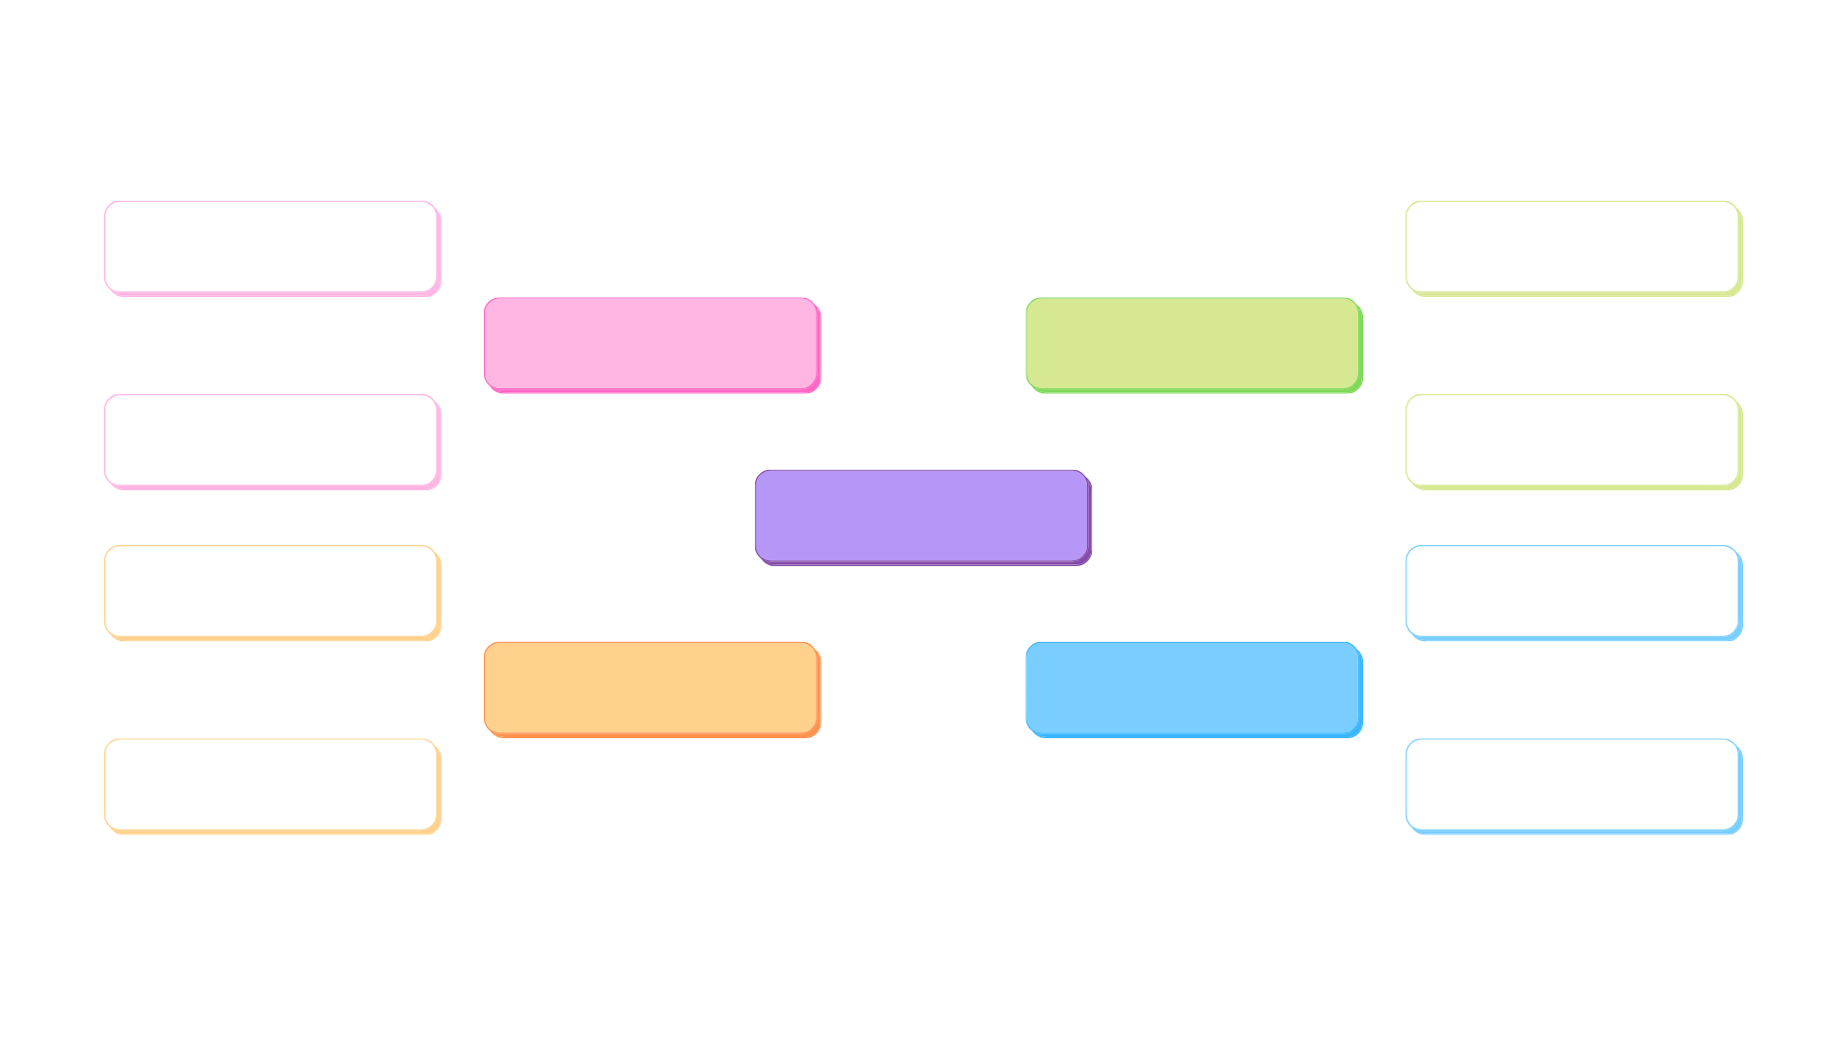
System Architecture Overview
Key Components
Functional Flow
Admin Control
Firebase Firestore stores tickets and events securely.
Booking form → EmailJS sends tickets → QR API generates codes.
Dashboard for event CRUD and ticket validation.

Slide 7
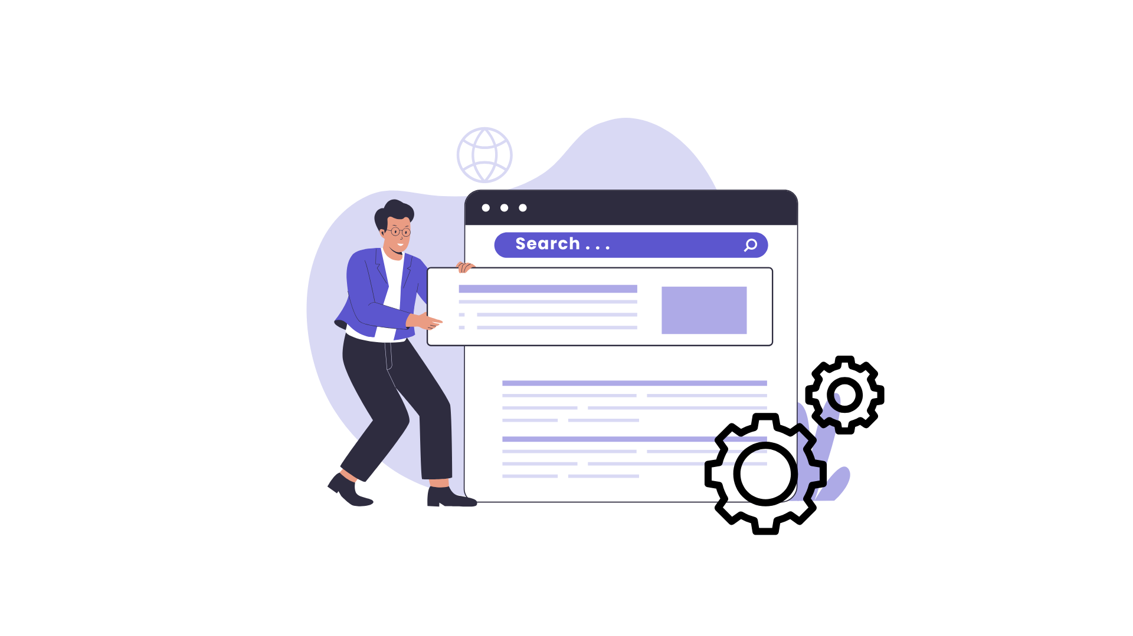
Features Of EventTix
User Features
Admin Features
Real-time event listing
Firebase-based secure login
Secure booking form with card-style inputs
CRUD event management
Email delivery with QR codes
QR code/manual ticket verification
Ticket dashboard for access
Special pass generation

Slide 8
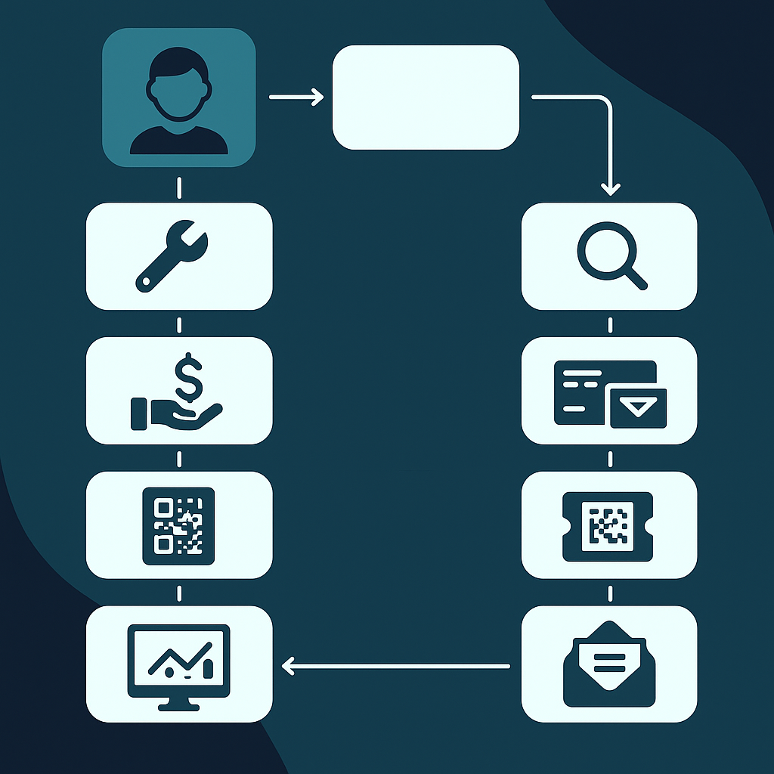


Workflow & User Journey
User Workflow
Browse events
Book ticket with details
Receive ticket email
Use QR or Ticket ID for entry
Admin Workflow
Login to dashboard
Manage events and tickets
Validate tickets at entry
Mark tickets as used

Slide 9
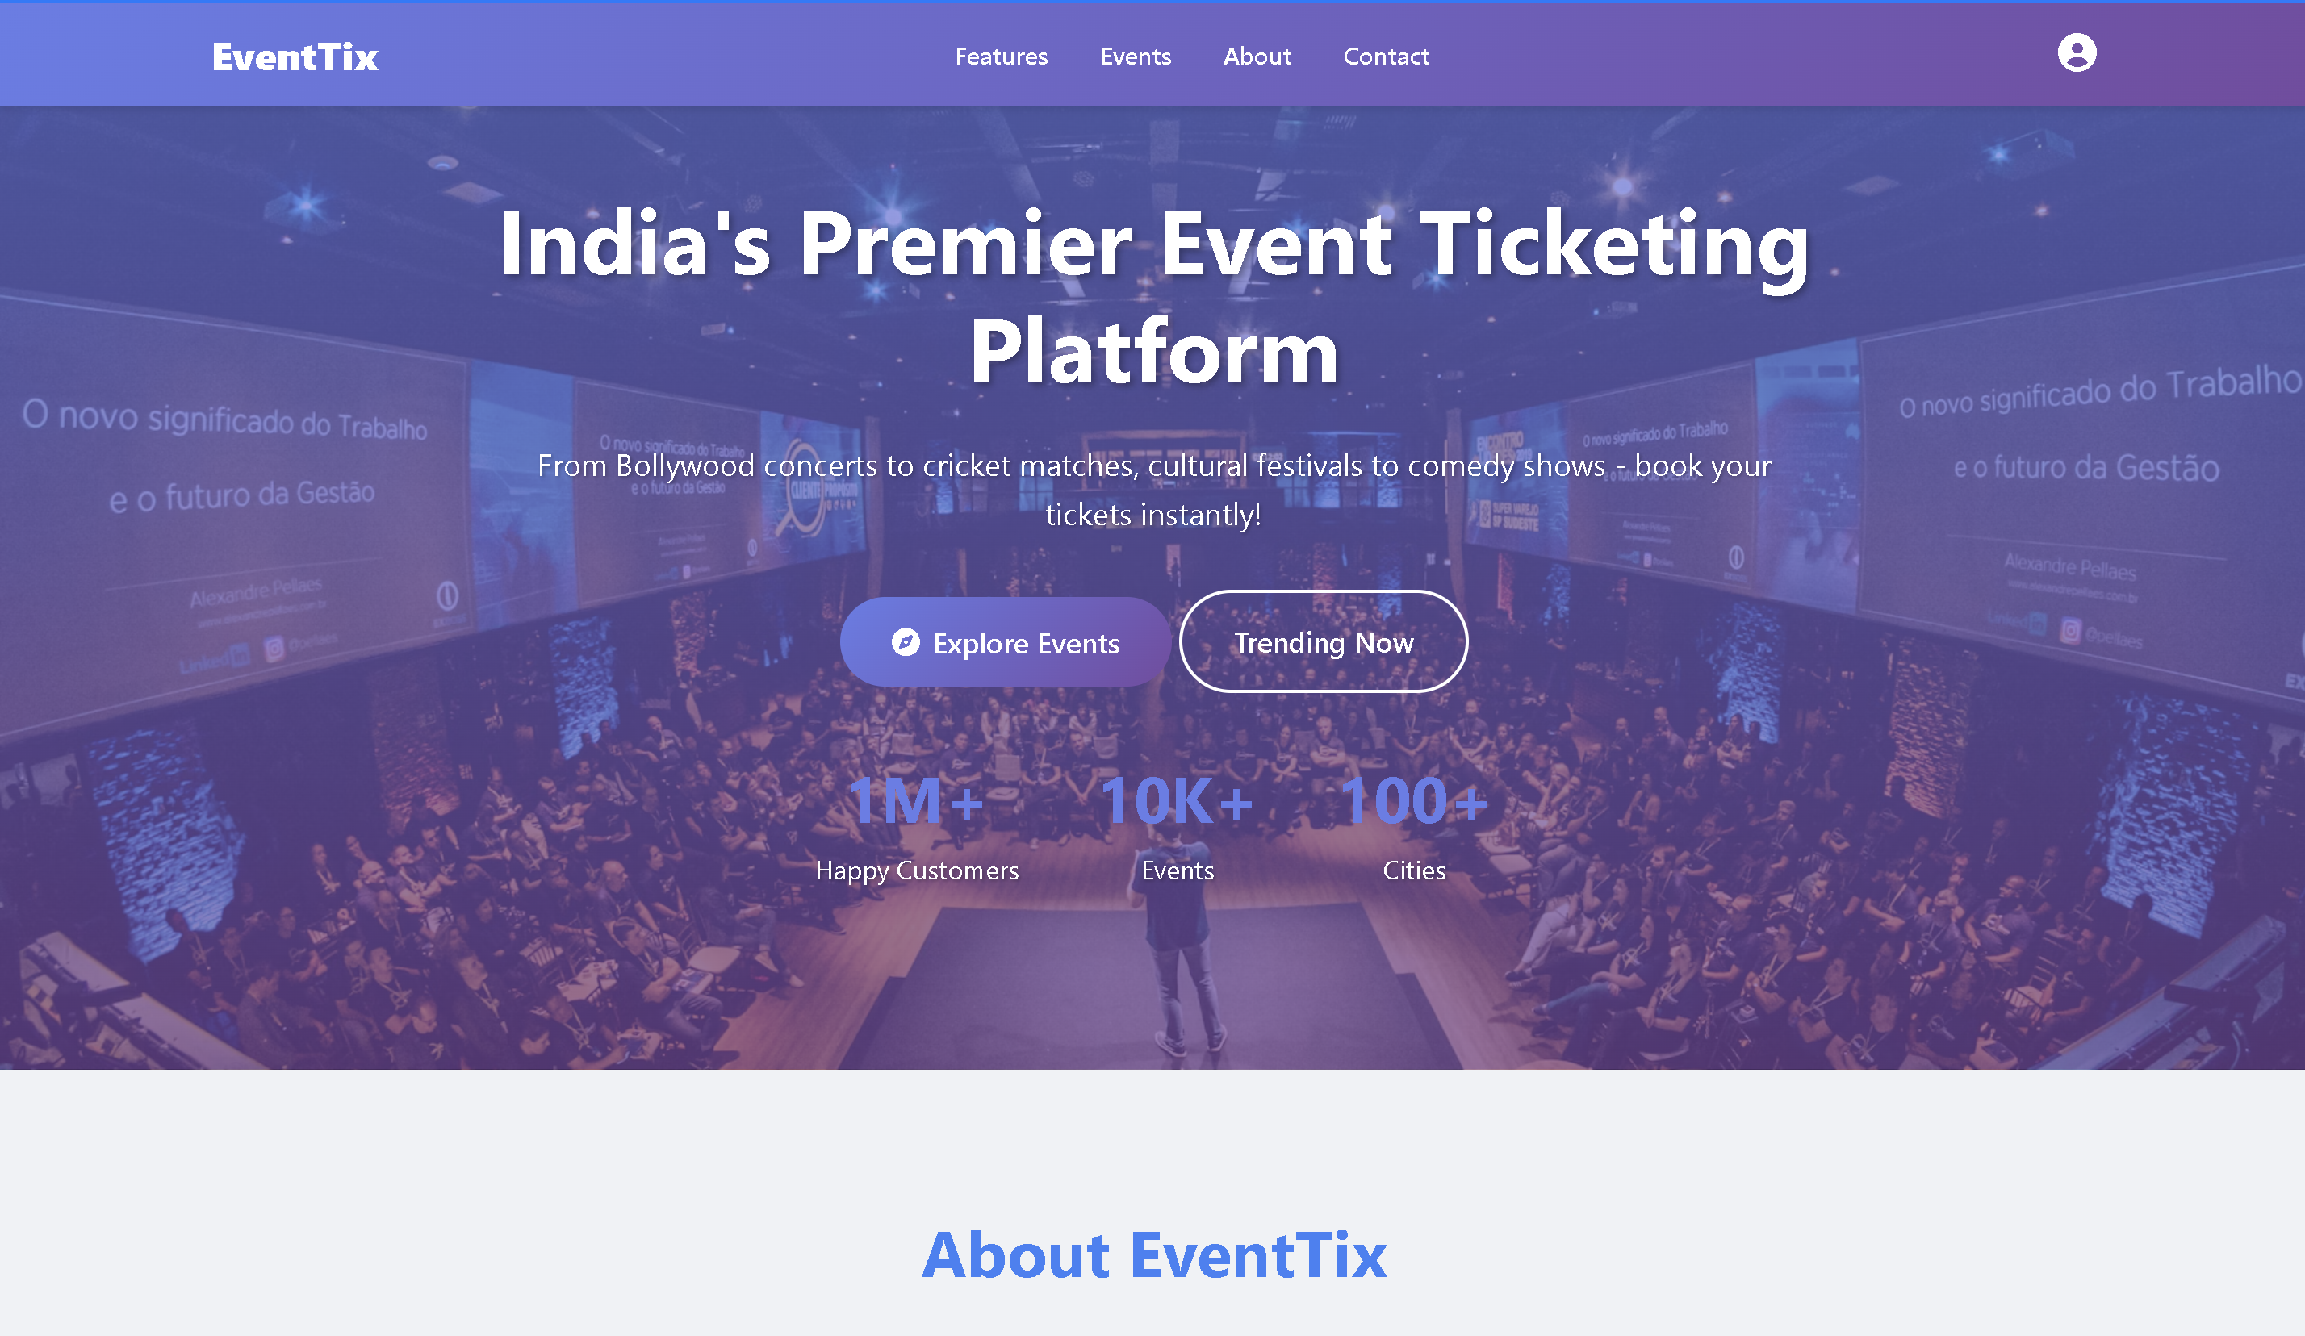
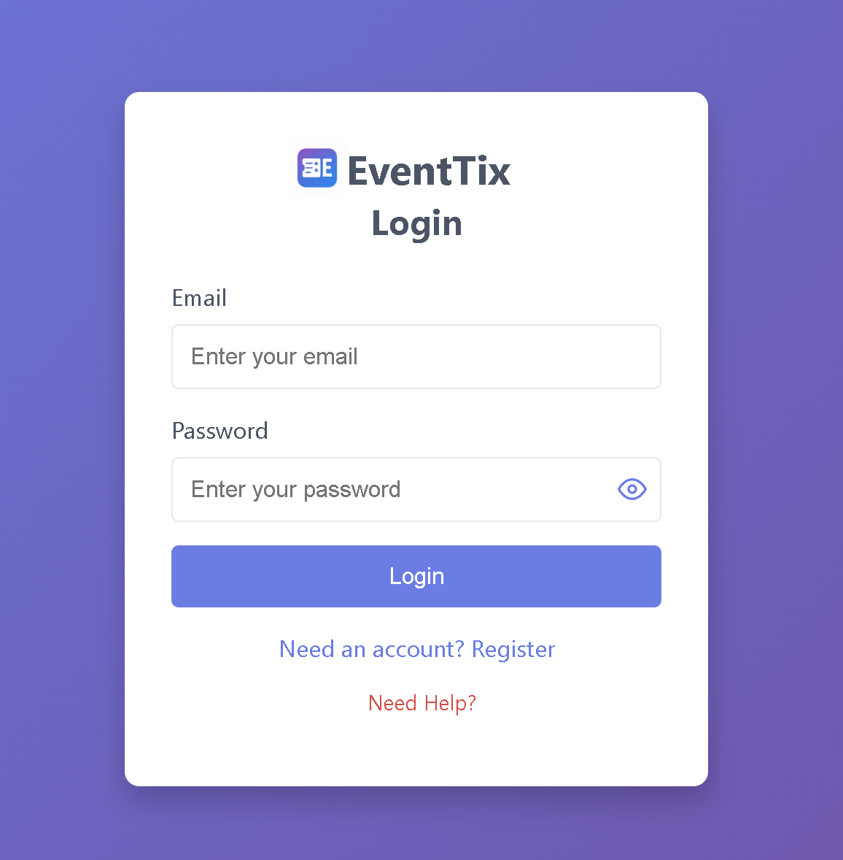
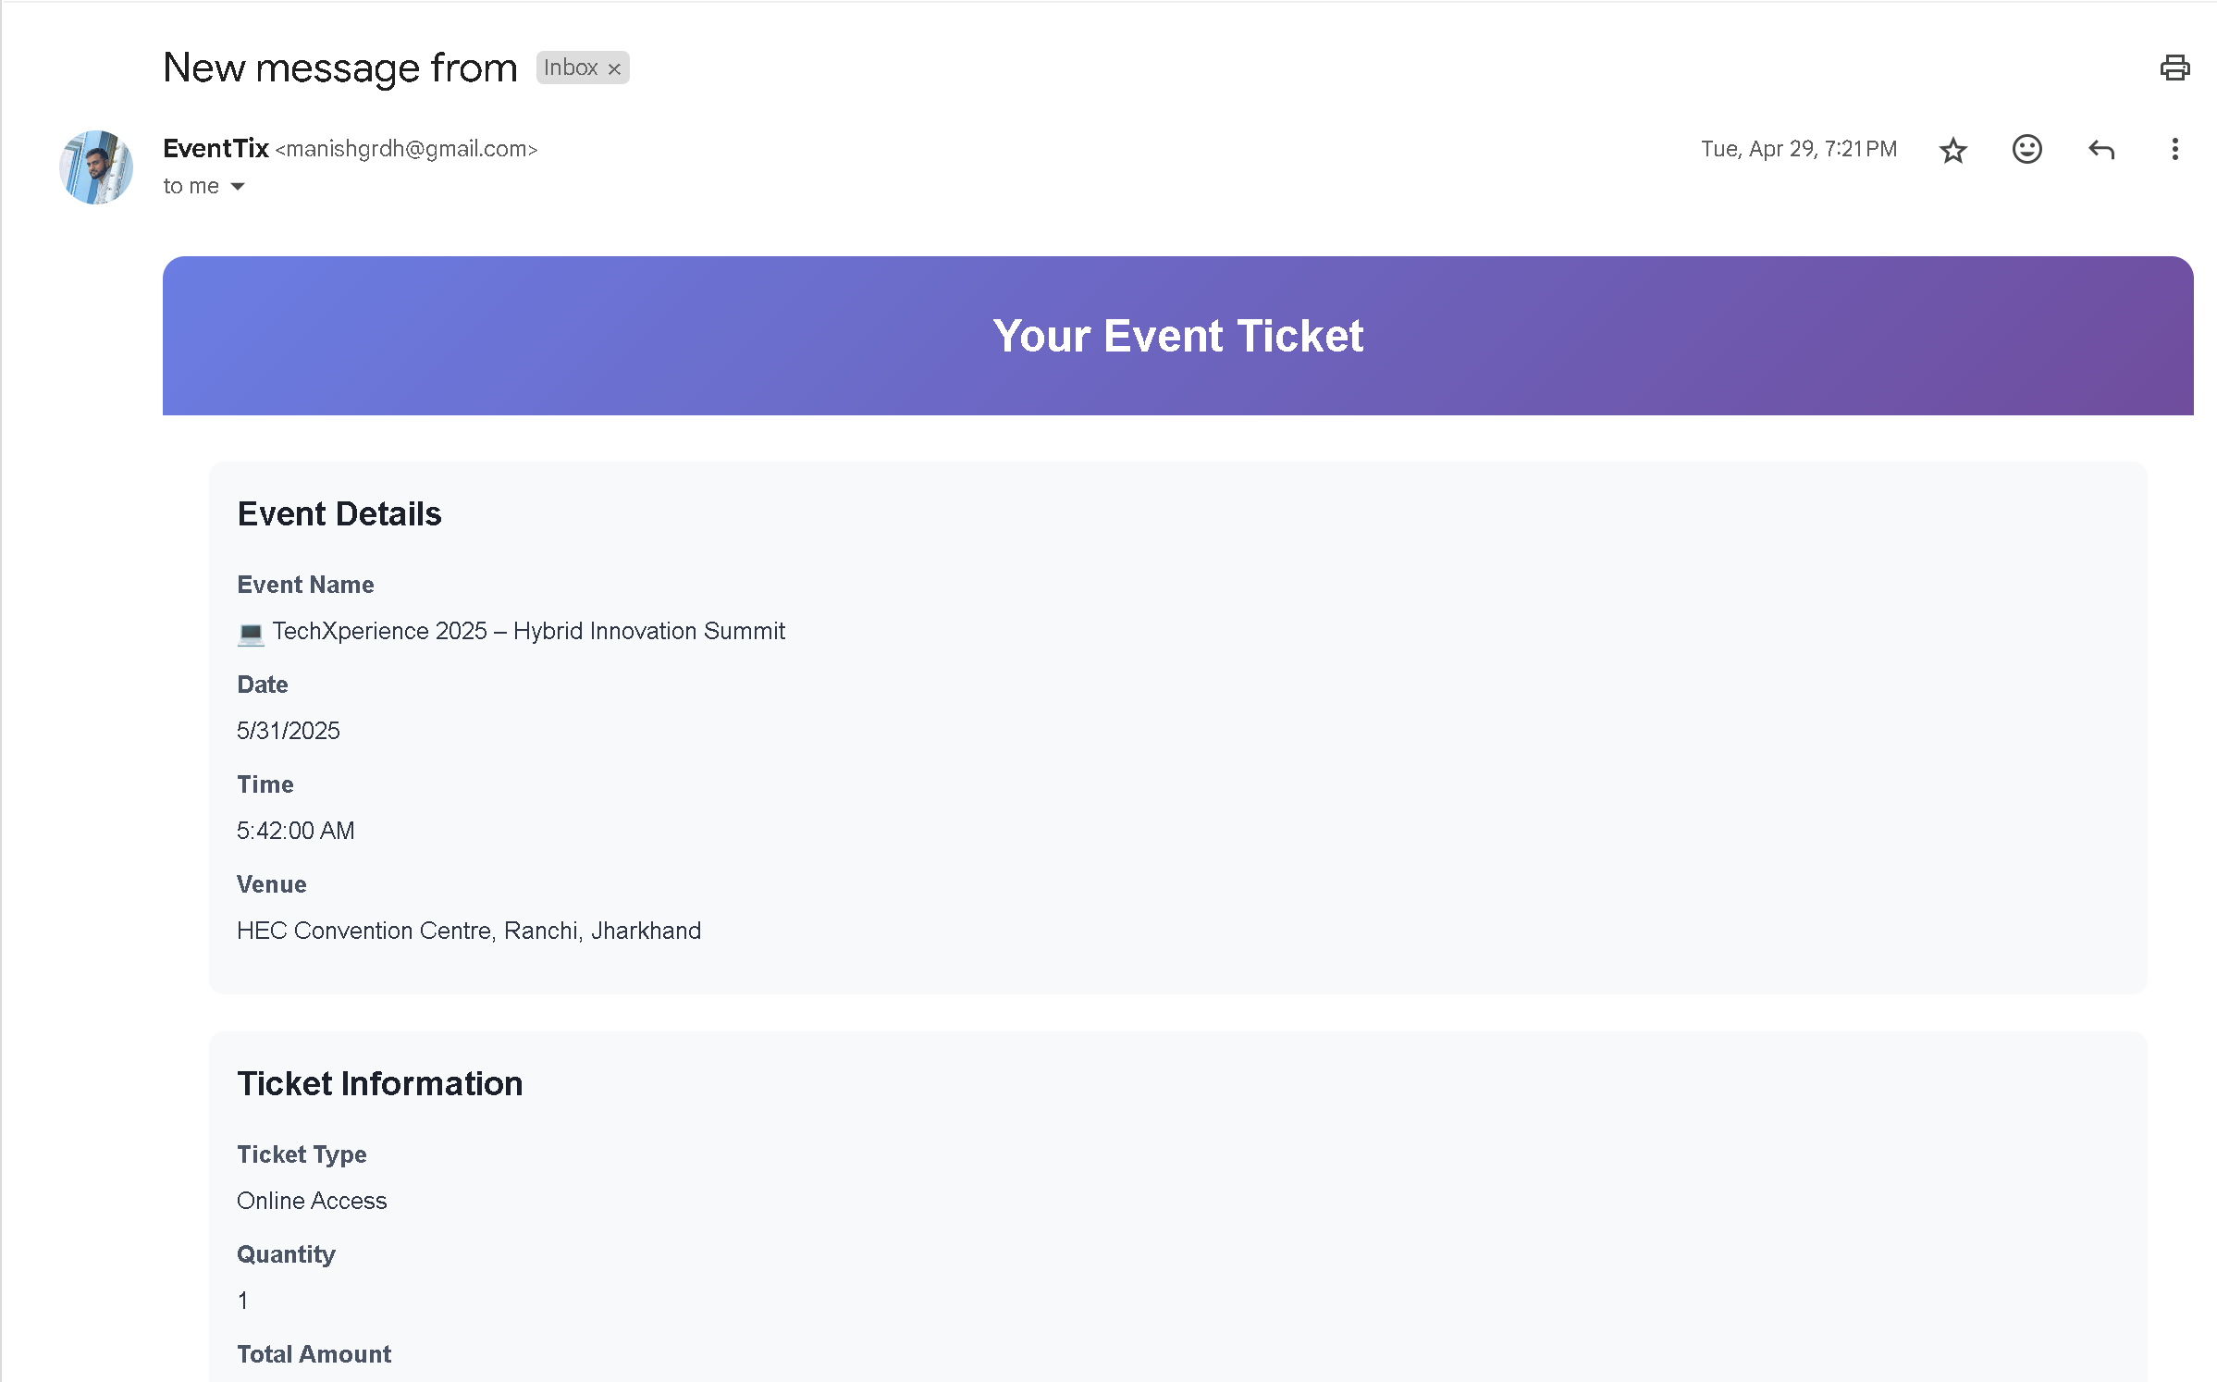
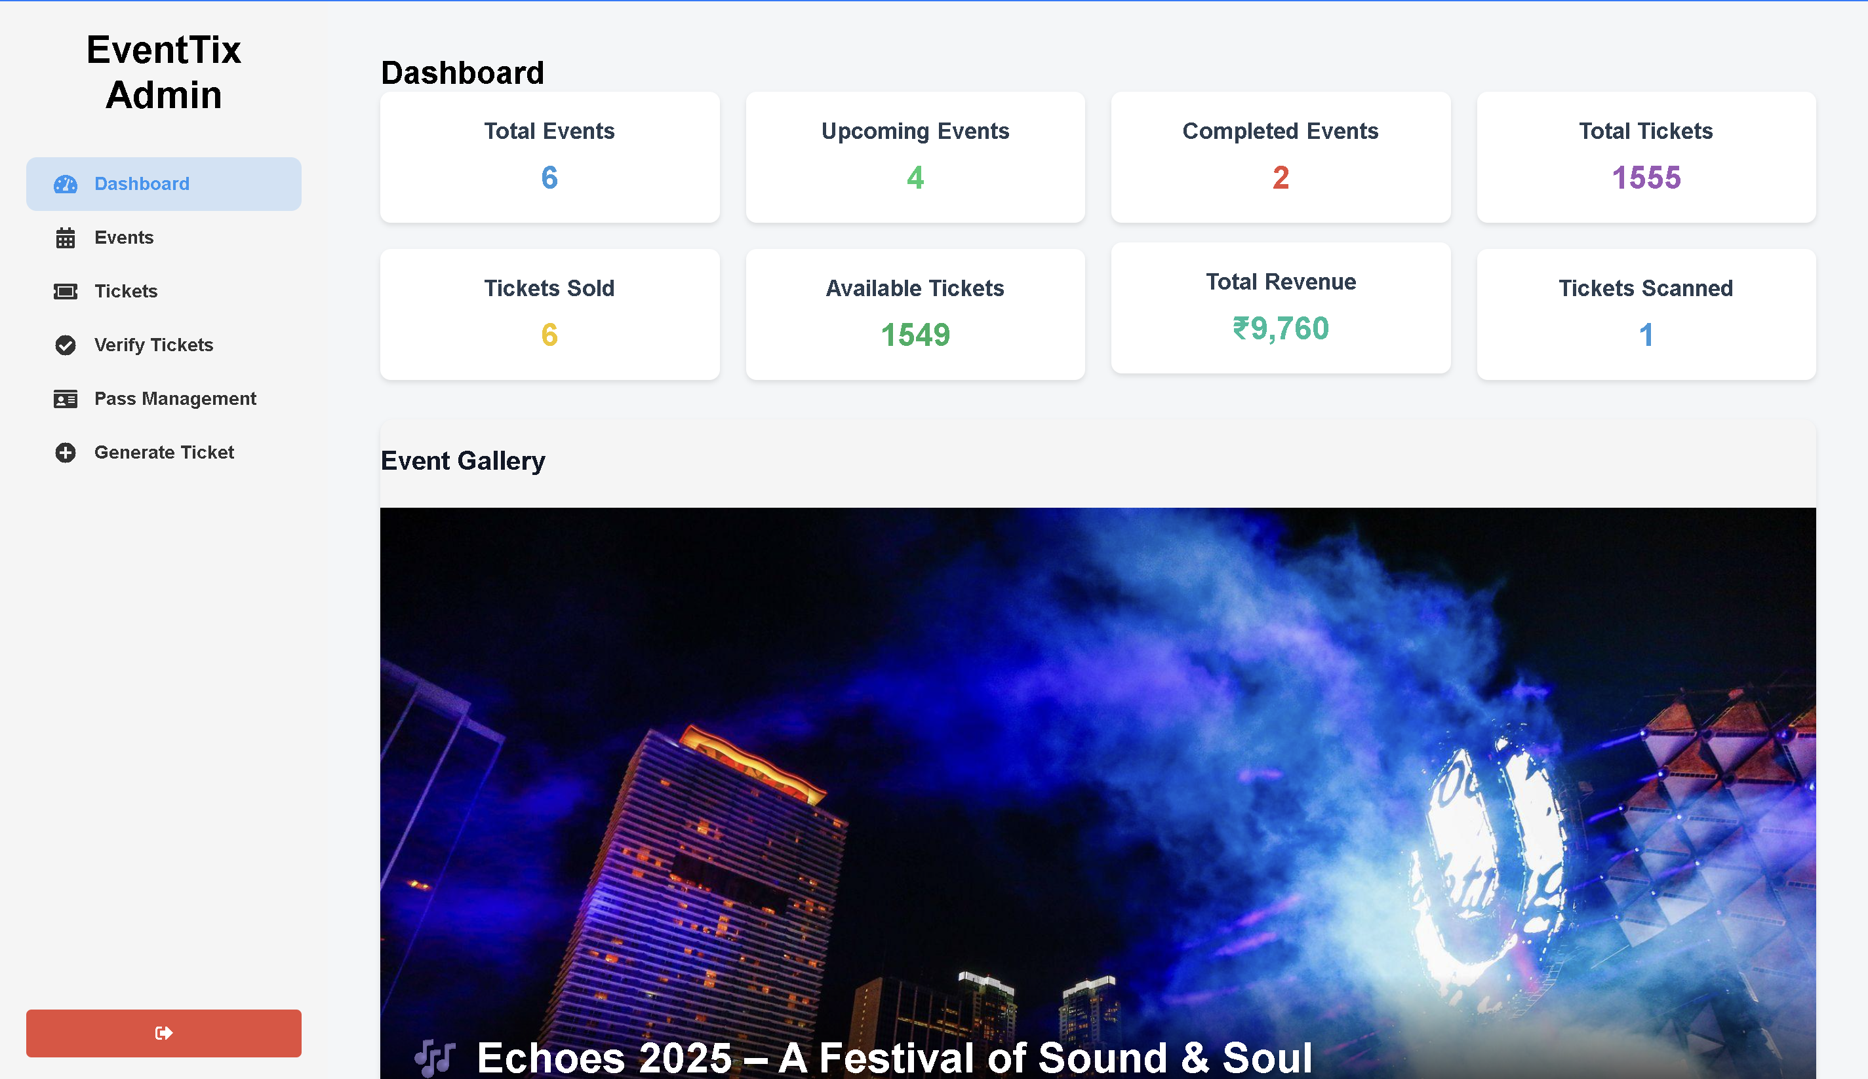
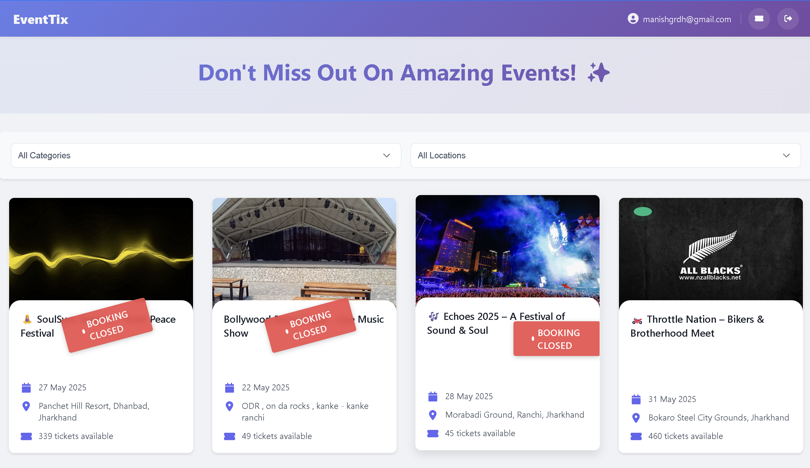
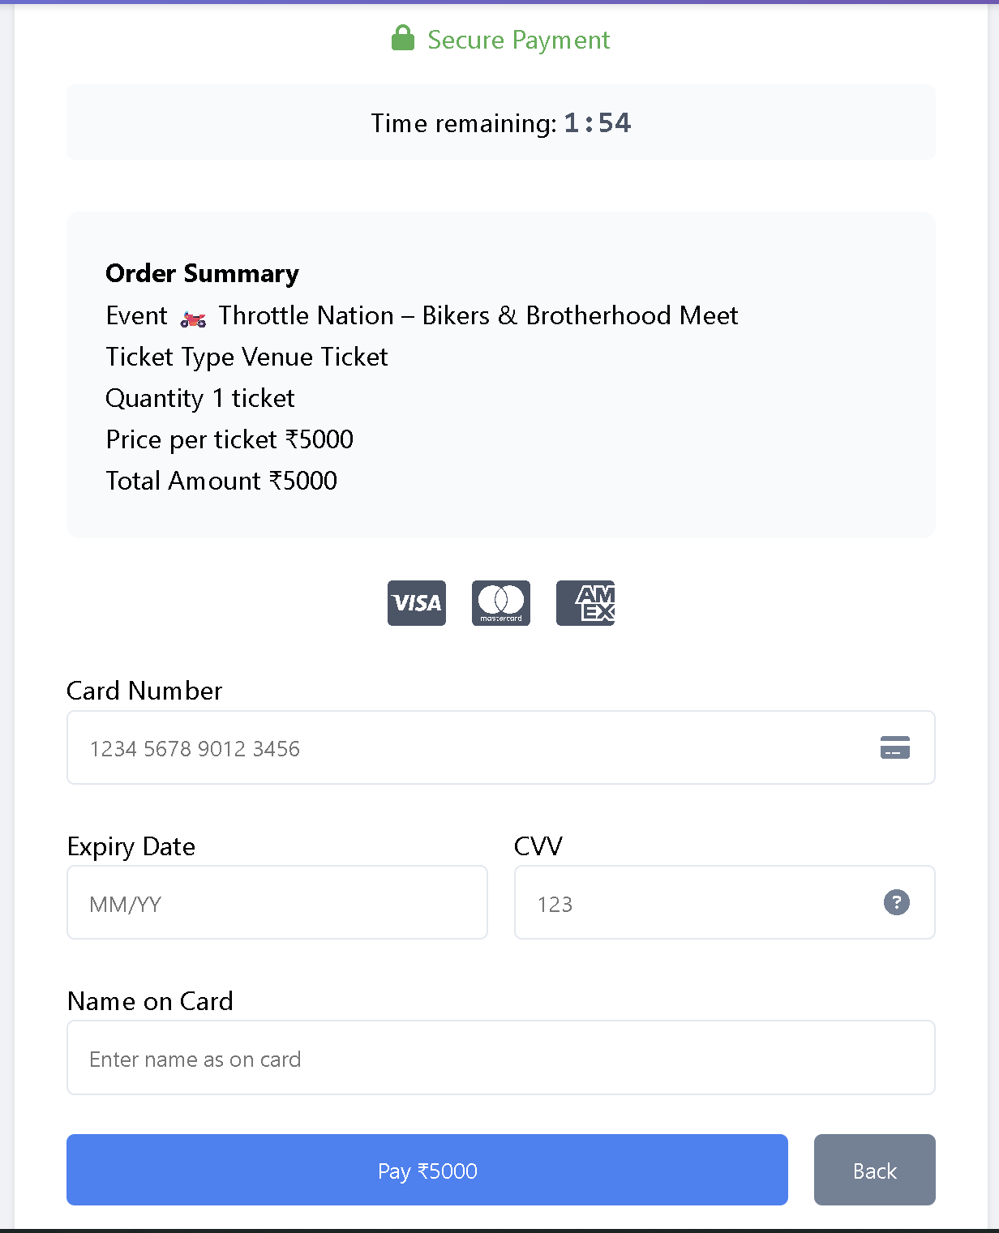
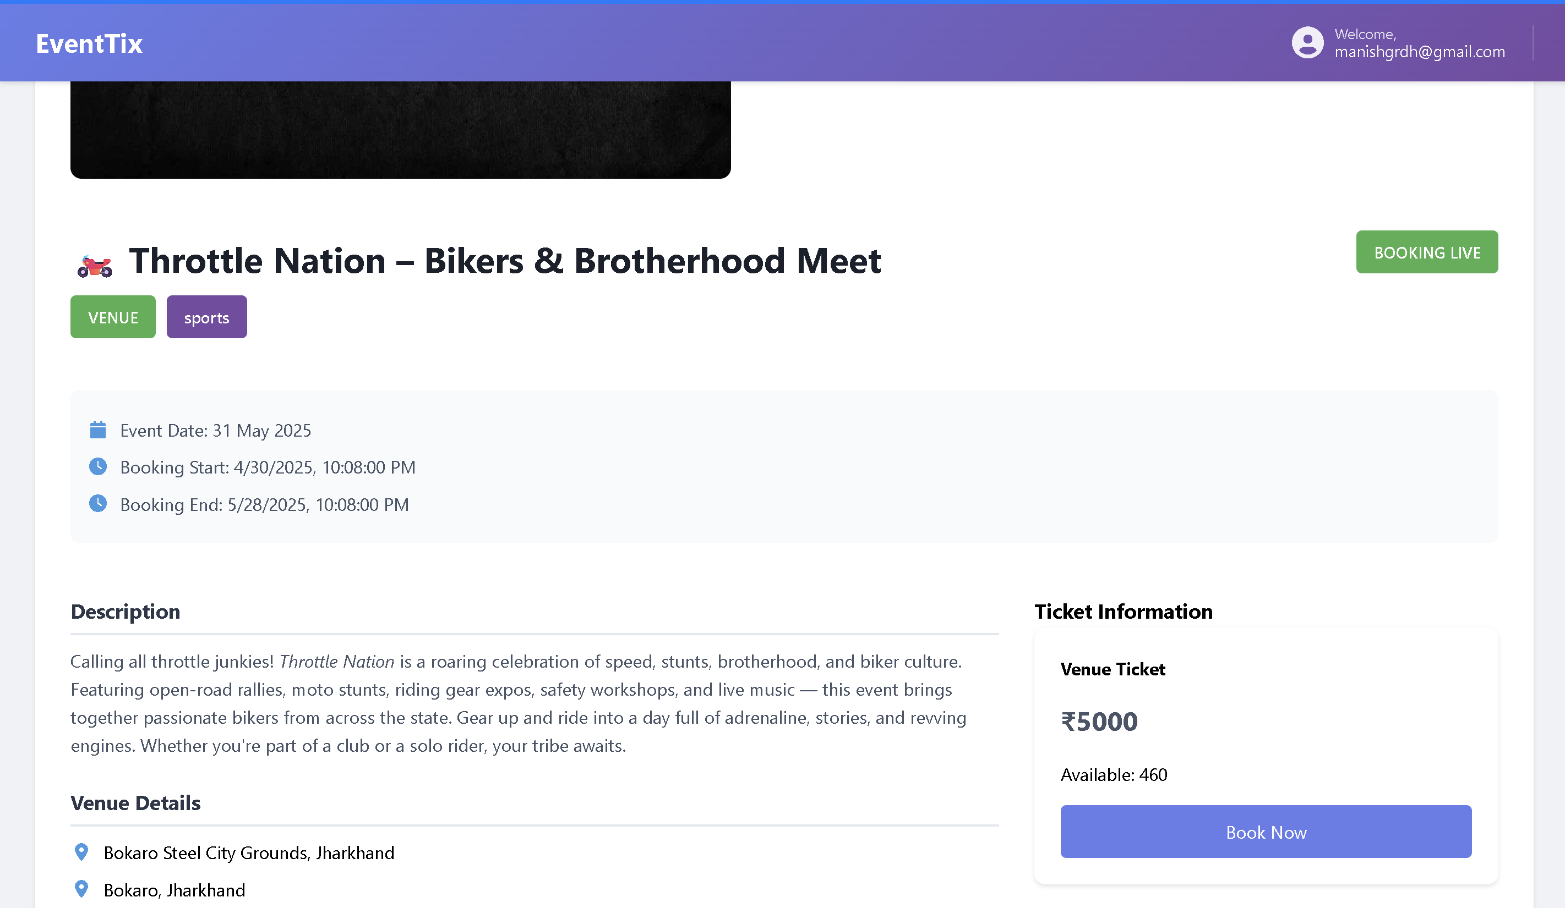
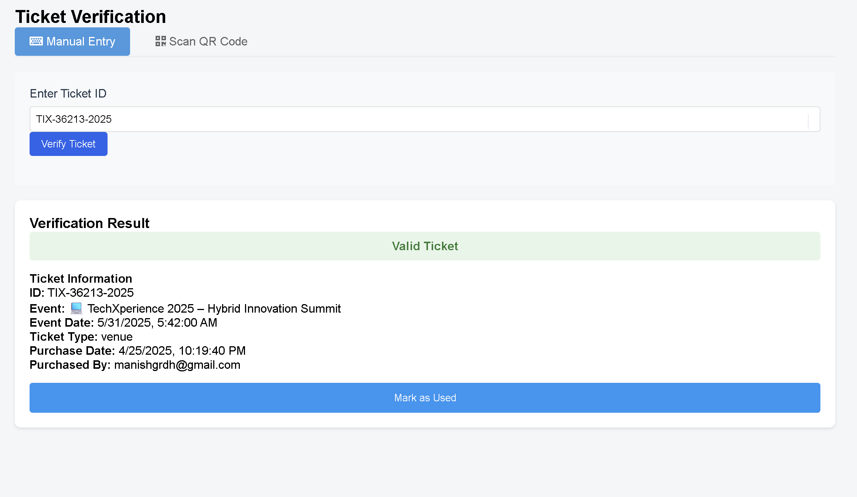
UI Overview & Screenshots
Home Page
Login Page
Ticket Email
Admin Dashboard
User Dashboard
Payment Page
Event Detail
Ticket Verification Page

Slide 10

Challenges & Learnings
Key Challenges
Persistent background scripts for extensions
Accurate QR code scanning and generation
EmailJS limits on content format
Ensuring unique ticket validation
Multi-browser compatibility issues
Learnings
Firebase real-time updates
JavaScript form validations
Async programming with Promises
Third-party API integration skills

Slide 11
Conclusion & Future Scope
Conclusion
Future Enhancements
Email Resend Option: Allow users to resend tickets to their email in case they lose the original.
Multi-language Support: Make the platform accessible to a wider audience.
Mobile App Integration: Extend the platform to Android/iOS for on-the-go access.
Advanced Analytics Dashboard: For admins to track ticket sales, attendee stats, and engagement.
Role-Based Admin Access: Add support for moderators, event partners, or volunteers with limited admin rights.
Firebase Authentication Upgrade: Incorporate advanced security features like OTP login and OAuth.
Push Notifications: Notify users about upcoming events, ticket confirmation, and last-minute changes.
The EventTix system successfully delivers a comprehensive, user-friendly platform for modern event ticketing and verification. It streamlines the entire process — from event creation, ticket booking, and secure online payments to QR-based ticket validation. Its intuitive dashboards for both users and admins ensure smooth navigation and efficient management of events. This project addresses the growing demand for digital event management solutions and sets a solid foundation for scalable real-world implementation.

Slide 12


